Slide 1
Five Key Leadership Concepts: Challenges and Opportunities
Niels-Erik Andreasen
Global Leadership Conference—January 29–30, 2013
Bali, Indonesia

Slide 2
I. The effective Christian leader focuses first on people and then on organizations
Text
Jesus said: “Do you truly love me? Feed my sheep.” (John 21:15)
Key concept
The leader is a pastor/shepherd of people.

Slide 3
I. The effective Christian leader focuses first on people and then on organizations
The challenge: The greatest temptation for a Christian leader is to begin with the organization.
Organization first > people second > goals/gains are the expected outcomes
The opportunity: The effective Christian leader reverses the order and begins with people.
People first > organization second > impact/mission are the expected outcomes

Slide 4
I. The effective Christian leader focuses first on people and then on organizations
Illustration: The current discussion of women in ministry and ordination
Leadership has carefully considered church policy, ecclesiastical authority, theology, church unity, Scripture, etc. in search for an answer. This is not wrong, but it focuses on the organization: what is best for it.
Women members account for 60–70% of the people in our church. Should not their views be sought in the matter? How can ministry best support them? Male pastors only, or female pastors too. What would happen if we took a people/member centered approach?

Slide 5
I. The effective Christian leader focuses first on people and then on organizations
Christian leaders should ask both questions—the organizational question and the people question. The organizational question will focus on goals and gain, the people question will focus on mission and impact. The people question should be given priority in Christian leadership.

Slide 6
II. The effective Christian leader commits to innovation, and does not resist it.
Text
Jesus said: “Behold, I make all things new.” (Rev. 21:5)
Key concept
The leader is an innovator.

Slide 7
II. The effective Christian leader commits to innovation, and does not resist it.
The challenge: How can we ever change what we believe is changeless?
Christian institutions that change do not always change for the better, e.g. colleges that were once Christian are no longer. Denominations change and some shrink. Change can be dangerous.
The opportunity: How can we not make changes for stronger mission and greater impact?
Jesus and Paul were change agents. Subsequent Christian leaders have changed the direction of the church and its mission repeatedly, e.g. Augustine, Luther, Calvin, Wesley, White. Christian leaders must effect change, innovation, or they will be left behind.

Slide 8
II. The effective Christian leader commits to innovation, and does not resist it.
Illustration: Two educational institutions in the United States, but they could be anywhere. One changed repeatedly; the other stalled.

Slide 9
II. The effective Christian leader commits to innovation, and does not resist it.
Andrews University
1874–1901 Battle Creek College, urban, traditional, small (less than 100 students).
1901–1959 Emmanuel Missionary College, changed: rural, reform college, missionary, work study, a leading Adventist college.
1959–2010 Andrews University, changed again: graduate, international, accredited, research, 3,500 students.
2010–___ And changed once more: Andrews and Griggs, distance education, K–12, worldwide, online, 12,000 students.

Slide 10
II. The effective Christian leader commits to innovation, and does not resist it.
Atlantic Union College
1882–1922: South Lancaster Academy, Lancaster Junior College, Atlantic Union college
1933–1954: BA degrees (1933), accredited (1945), B.S. degree (1954)
1954–2011: MEd degrees (1990), failed to reorganize (1996), lost accreditation (2008), closed (2011)
There were many reasons, but the main one: AUC was surrounded by change but did not change/innovate in time.

Slide 11
III. The effective Christian leader leads from the ground up, not from the top down.
Text
Jesus said to his disciples: “Give them to eat.” (Matt. 14:16)
Key concept
The leader begins with the frontline workers, not in the board room.

Slide 12
III. The effective Christian leader leads from the ground up, not from the top down.
The challenge: Christian leaders tend to be hierarchical in outlook, like some church organizations.
That is not wrong, but it can be inhibiting and outright dangerous, because it isolates the leader from the best ideas for mission and impact. It has been the dominant leadership style in some churches, in the old European monarchies, during the industrial revolution, and in GM until recently. Some say it is prevalent in certain Asian and African economies.

Slide 13
III. The effective Christian leader leads from the ground up, not from the top down.
The opportunity: Leaders learn from the front line workers, and lead from there.
The problem with leadership from the top down is that most good ideas grow up from the bottom, and top down leadership misses out on them. Some of the best ideas for progress come from the frontline workers and filter up from there. Not all bottom-up ideas are good of course, many have to be discarded, but what are left are among the best.

Slide 14
III. The effective Christian leader leads from the ground up, not from the top down.
Illustration:
Think for a minute about some of the best ideas in the world and in the church and ask where they came from. The board room and the CEO at the top, or from the frontline or the work bench at the bottom?

Slide 15
III. The effective Christian leader leads from the ground up, not from the top down.
In society generally:
In our church specifically:
The light bulb: T. Edison
Polio vaccine: J. Salk
Heart transplant: C. Bernard
Apple computers: S. Jobs
The human genome: Aristides Patrinos
Radio evangelism: H.M.S. Richards
TV evangelism: W. Fagal
Biblical archaeology: L. Wood and S. Horn
Biblical research: J.N. Andrews
Adventist health study: Gary Fraser (LLU)

Slide 16
IV. The effective Christian leader seeks value first, then success.
Text
“But seek first His kingdom and His righteousness, and all these things will be given to you as well.” (Matt. 6:33)
Key concept
The leader places value before success.

Slide 17
IV. The effective Christian leader seeks value first, then success.
What do we mean by leadership for “value”?
Gary Hamel is an internationally known leadership and management strategist (and an Andrews alumnus). His latest book is entitled: What Matters Now. From the chapter, “Reclaiming the Noble,” pp.35–38.

Slide 18
IV. The effective Christian leader seeks value first, then success.
The challenge: Most of us prefer to describe our leadership using “success words:”
Superior, advantage, management, differentiation, gain, focus, discipline, accountability, progress, first, flagship, effectiveness. Nothing wrong with these. They will bring success, but do they also add value? Do these goals quicken your pulse? Do they speak to your heart? Are they “good” in any cosmic sense? Do they excite? Do they have a mission? G. Hamel

Slide 19
IV. The effective Christian leader seeks value first, then success.
The opportunity: Watch what happens when we instead describe our leadership with “values words:”
Leaders like Michelangelo, Galileo, Jefferson, Gandhi, William Wilberforce, William Miller, Martin Luther King Jr., Mother Theresa, Ellen G. White and Sir Edmund Hillary. What were the ideals that inspired these individuals to acts of greatness? Here are some: Beauty, truth, wisdom, justice, charity, hope, love, fidelity, joy, courage, faith and honor.

Slide 20
IV. The effective Christian leader seeks value first, then success.
Illustration of people who led by adding value, not merely success:
Missionaries Anna and Fernando Stahl of Peru
Maestro Herbert Blomstedt of Sweden
Pastor William Harrison Anderson of Rhodesia
Dr. Benjamin Carson, neurosurgeon
Dr. Ellsworth Wareham of Loma Linda

Slide 21
V. The effective Christian leader follows a vision, not convention.
Text
Paul said: “Forgetting those things which are behind and reaching forward to those things which are ahead.” (Phil. 3:13)
Key concept
The effective leader is visionary like an artist.

Slide 22
V. The effective Christian leader follows a vision, not convention.
The challenge: Leaders who follow conventions copy each other.
Me too: It worked well for him, let me do the same.
Once again: It worked before, let us do it again.
Over there: It worked over there, let us do it here.

Slide 23
V. The effective Christian leader follows a vision, not convention.
The opportunity: Leaders who are visionary will see things that have not yet be seen, hear things that have not yet be heard, describe things not yet made clear and take the organization in truly “new directions.”
The visionary leader is visionary like an artist!

Slide 24
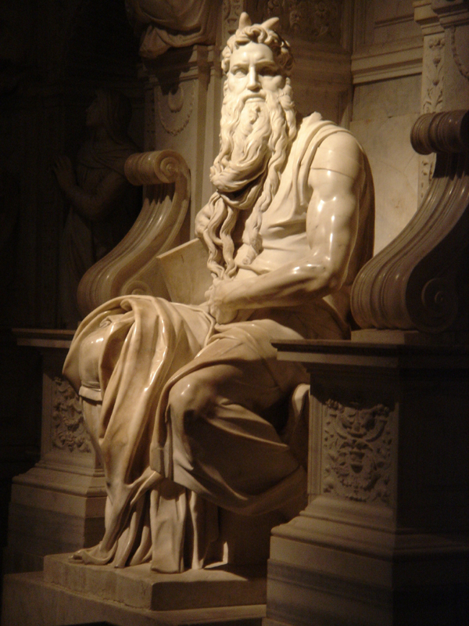

Slide 25
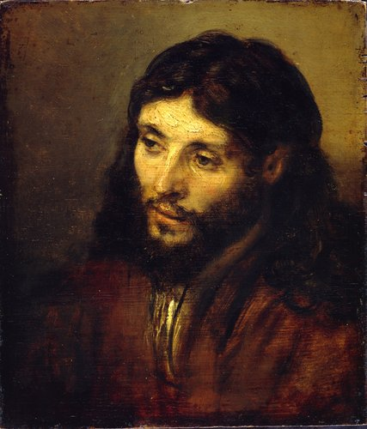

Slide 26
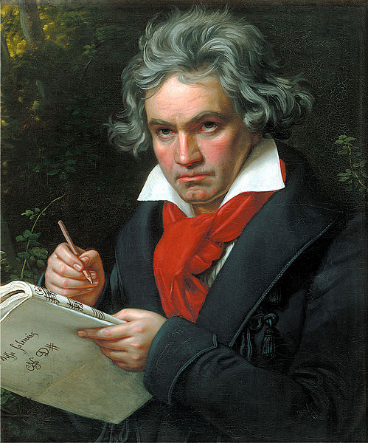

Slide 27
V. The effective Christian leader follows a vision, not convention.
In summary, we often think of leaders as though they were engineers: they pull levers, oil the wheels, crank up the machinery, call committees, appropriate budgets to make familiar things happen. But true visionary leaders, like artists, make things happen that are entirely new. They are visionaries, inventors, leading us to new insights. That is the greatest calling of leadership.

Slide 28
V. The effective Christian leader follows a vision, not convention.
Illustration: What can we do for our young people and young adults in our church?
Here are two illustrations, one from NAD and one from SID. Consider these numbers:

Slide 29
V. The effective Christian leader follows a vision, not convention.
NAD: Percentage distribution of our population in the USA:
Age 14–31 32–43 44–62 63+
26% 16% 25% 12%
Percentage distribution of our church in the USA:
Age 14–31 32–43 44–62 63+
14% 10% 30% 31%

Slide 30
V. The effective Christian leader follows a vision, not convention.
How do we capture these people? What visionary leadership do we have?
Consider the NAD camporee attendance:
1999 2004 2009 2014
18,469 28,374 34,003 1,460 so far

Slide 31
Here is what 34,000 youth and young adults in one place looks like!

Slide 32
V. The effective Christian leader follows a vision, not convention.
SID: 2.3 million members, 75% under 30. That is about 1.8 million youth/young adults (plus children not yet official members).
What are our visioning ideas for SID and all the other challenges in our church?

Slide 33
Five Key Leadership Concepts
People first
From the bottom up
Innovate
Values over success
Visionary

